Slide 1
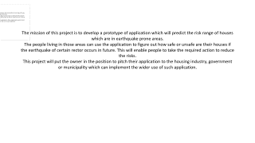
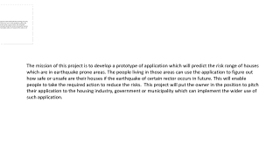
The mission of this project is to develop a prototype of application which will predict the risk range of houses which are in earthquake prone areas.
The people living in those areas can use the application to figure out how safe or unsafe are their houses if the earthquake of certain rector occurs in future. This will enable people to take the required action to reduce the risks.
This project will put the owner in the position to pitch their application to the housing industry, government or municipality which can implement the wider use of such application.

Slide 2
The mission of this pre-project is to create a pitch that will showcase our idea of a co-founding app that will facilitate people to find a co-founder to start a business.
The app will enable the user to see if there are other people interested in similar ideas, creating ideas or implementing ideas into a operational business. This will assist user to have a platform where they can share ideas, look for ideas that they are interested in and optimally set-up a business.
Likeminded ideas

